Slide 1
AI-Augmented Software Development Life Cycle
SEZG534
Akshaya Ganesan
CSIS, WILP

Slide 2
Contact Session: 8 – AI-Native SDLC

Slide 3
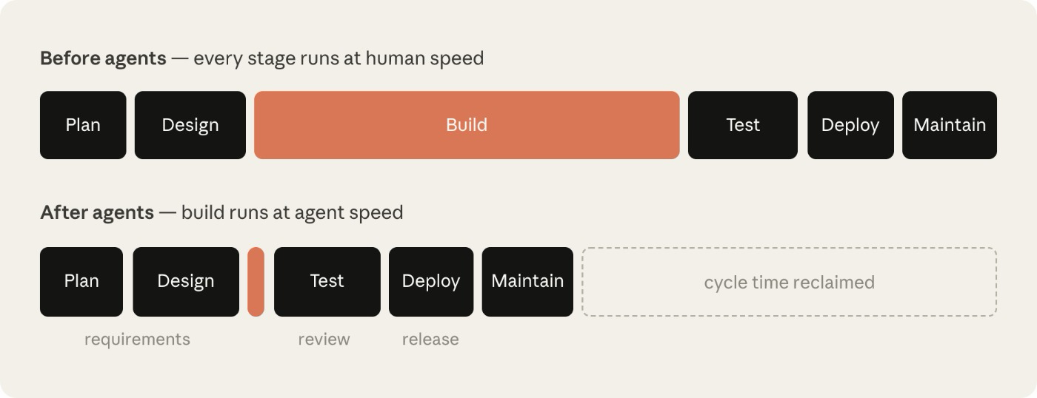
Traditional SDLC
The traditional software development lifecycle (SDLC) is process-heavy to ensure accountability and control at each step.
Image Ref: https://claude.com/blog/the-ai-native-sdlc-playbook

Slide 4
When code is no longer the bottleneck
The bottleneck moves to the stages on either side of the build phase: mainly plan, review/test, and deploy, which still run at human speed.
The controls stop matching reality and become intractable.
Reviewing each line by hand made sense when a person had written it, but it can't keep up once agents write most of the diff.
Governance costs increase because exceptions still route through meetings and committees that meet weekly or monthly.
The bottleneck moved: build collapses to agent speed while the stages around it still run at human speed.

Slide 5
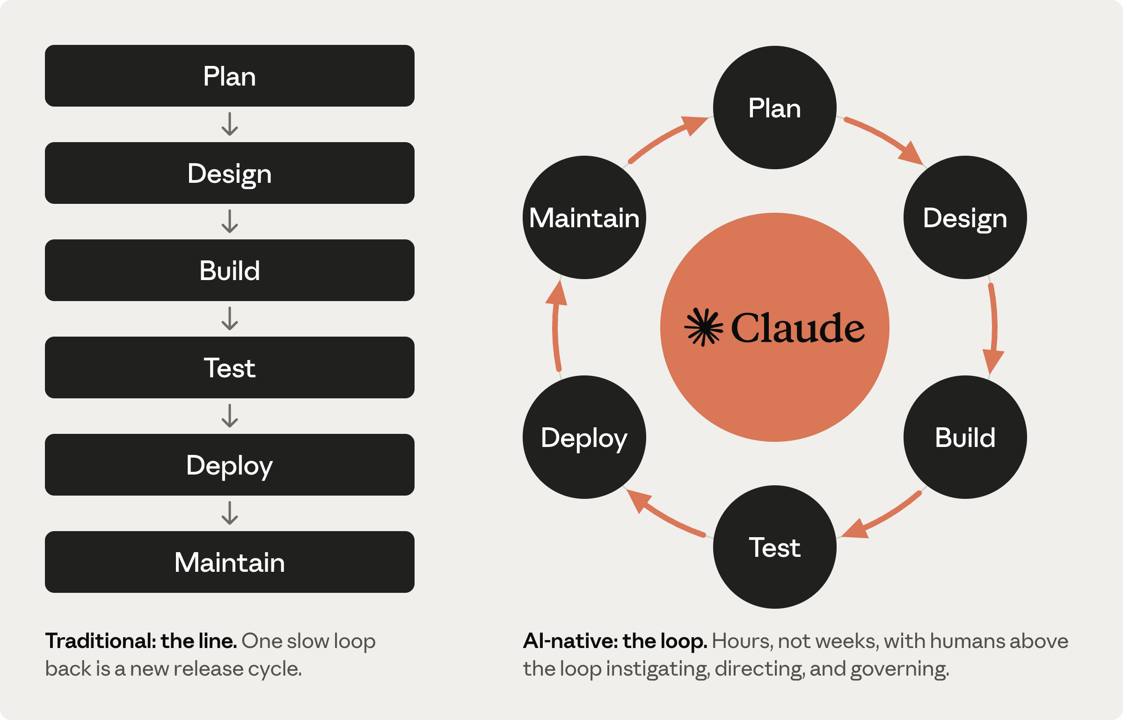
AI-native SDLC
The AI-native SDLC promotes automated handover and triggering of subsequent plays.
Address the manual handoff between the phases of the traditional SDLC.
Image Ref: https://claude.com/blog/the-ai-native-sdlc-playbook

Slide 6
Spec-Driven Development
A Spec-First Approach to AI-Native Engineering
Teams often ship software that works but still misses the original intent.
Prompt-first workflows can work well for simple tasks, but they often struggle as scope and complexity increase.
Spec-Driven Development (SDD) is a spec-first approach.
Teams define common guardrails, requirements, constraints, acceptance criteria, and edge cases up front, then use AI to generate code, tests, and supporting artifacts from that shared context.
In practice, the spec becomes the connective tissue across the lifecycle.

Slide 7
Spec-Driven-Development-Benefits
Less ambiguity and rework because requirements are clarified earlier.
Better alignment across product, engineering, and test through a shared source of truth.
Faster implementation because AI can generate against structured context.
More predictable delivery because validation is tied back to the original intent.

Slide 8
Tools
The ideas behind SDD matter only if teams can apply them consistently in day-to-day engineering work.
GitHub Spec Kit
Kiro
The AI-Native SDLC playbook-Anthropic

Slide 9
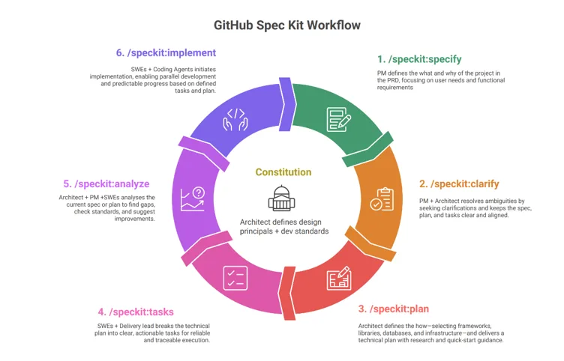
GitHub Spec Kit
  https://github.com/github/spec-kit
  An open-source tools, created by Microsoft

Slide 10
GitHub Spec Kit
GitHub Spec Kit has two key components
Specify CLI. A helper CLI that bootstraps your projects for SDD. It downloads the official templates from the GitHub repo for the coding agent and platform of your choice and sets up the SDD scaffolding in a way that the agent can start iterating on it.
A set of templates and helper scripts. This establishes the foundation for our SDD experience. Templates define what a spec looks like, what a technical plan encompasses for a given project, and how all of this is broken down into individual tasks that an AI agent can pick up and execute.

Slide 11
Kiro
Agentic AI by AWS
Kiro is available as a desktop IDE, a command-line interface, a web app, a mobile app, and a personal AI agent (Crew)
Workflow: Requirements → Design → Tasks
Every spec generates three key files that form the foundation of your specification:
  requirements.md (or bugfix.md) - Captures user stories, acceptance criteria, or bug analysis in structured notation
  design.md - Documents technical architecture, sequence diagrams, and implementation considerations
  tasks.md - Provides a detailed implementation plan with discrete, trackable tasks

Slide 12
Kiro
Kiro builds a dependency graph of the tasks in your tasks.md and groups independent tasks into waves:
  Wave 1 - all tasks with no dependencies. These run concurrently.
  Wave 2 - all tasks whose dependencies were satisfied by Wave 1. These run concurrently.
  Wave N - continues until all tasks are complete.
Waves execute sequentially; tasks within a wave execute concurrently.

Slide 13
Kiro
Kiro supports two types of specs to match your development needs:
Feature Specs: For building new features and capabilities in your application.
Bugfix Specs:For systematically diagnosing and fixing bugs with surgical precision while preventing regressions.
Steering Files: Kiro scans your repository to generate persistent context files (product.md, tech.md, and structure.md) so the AI permanently understands your project conventions without needing repetitive explanations in chat.
Available as an IDE application, plus a CLI, browser interface, and mobile companion app.

Slide 14
The AI-Native SDLC playbook
The plays are the core of the playbook and are grouped into six non-linear stages (Plan, Design, Build, Test, Deploy, Maintain).
Each play covers:
  What changes;
  Getting started;
  Concrete steps for implementation;
  Governance considerations; and
  How you measure whether it worked.

Slide 15
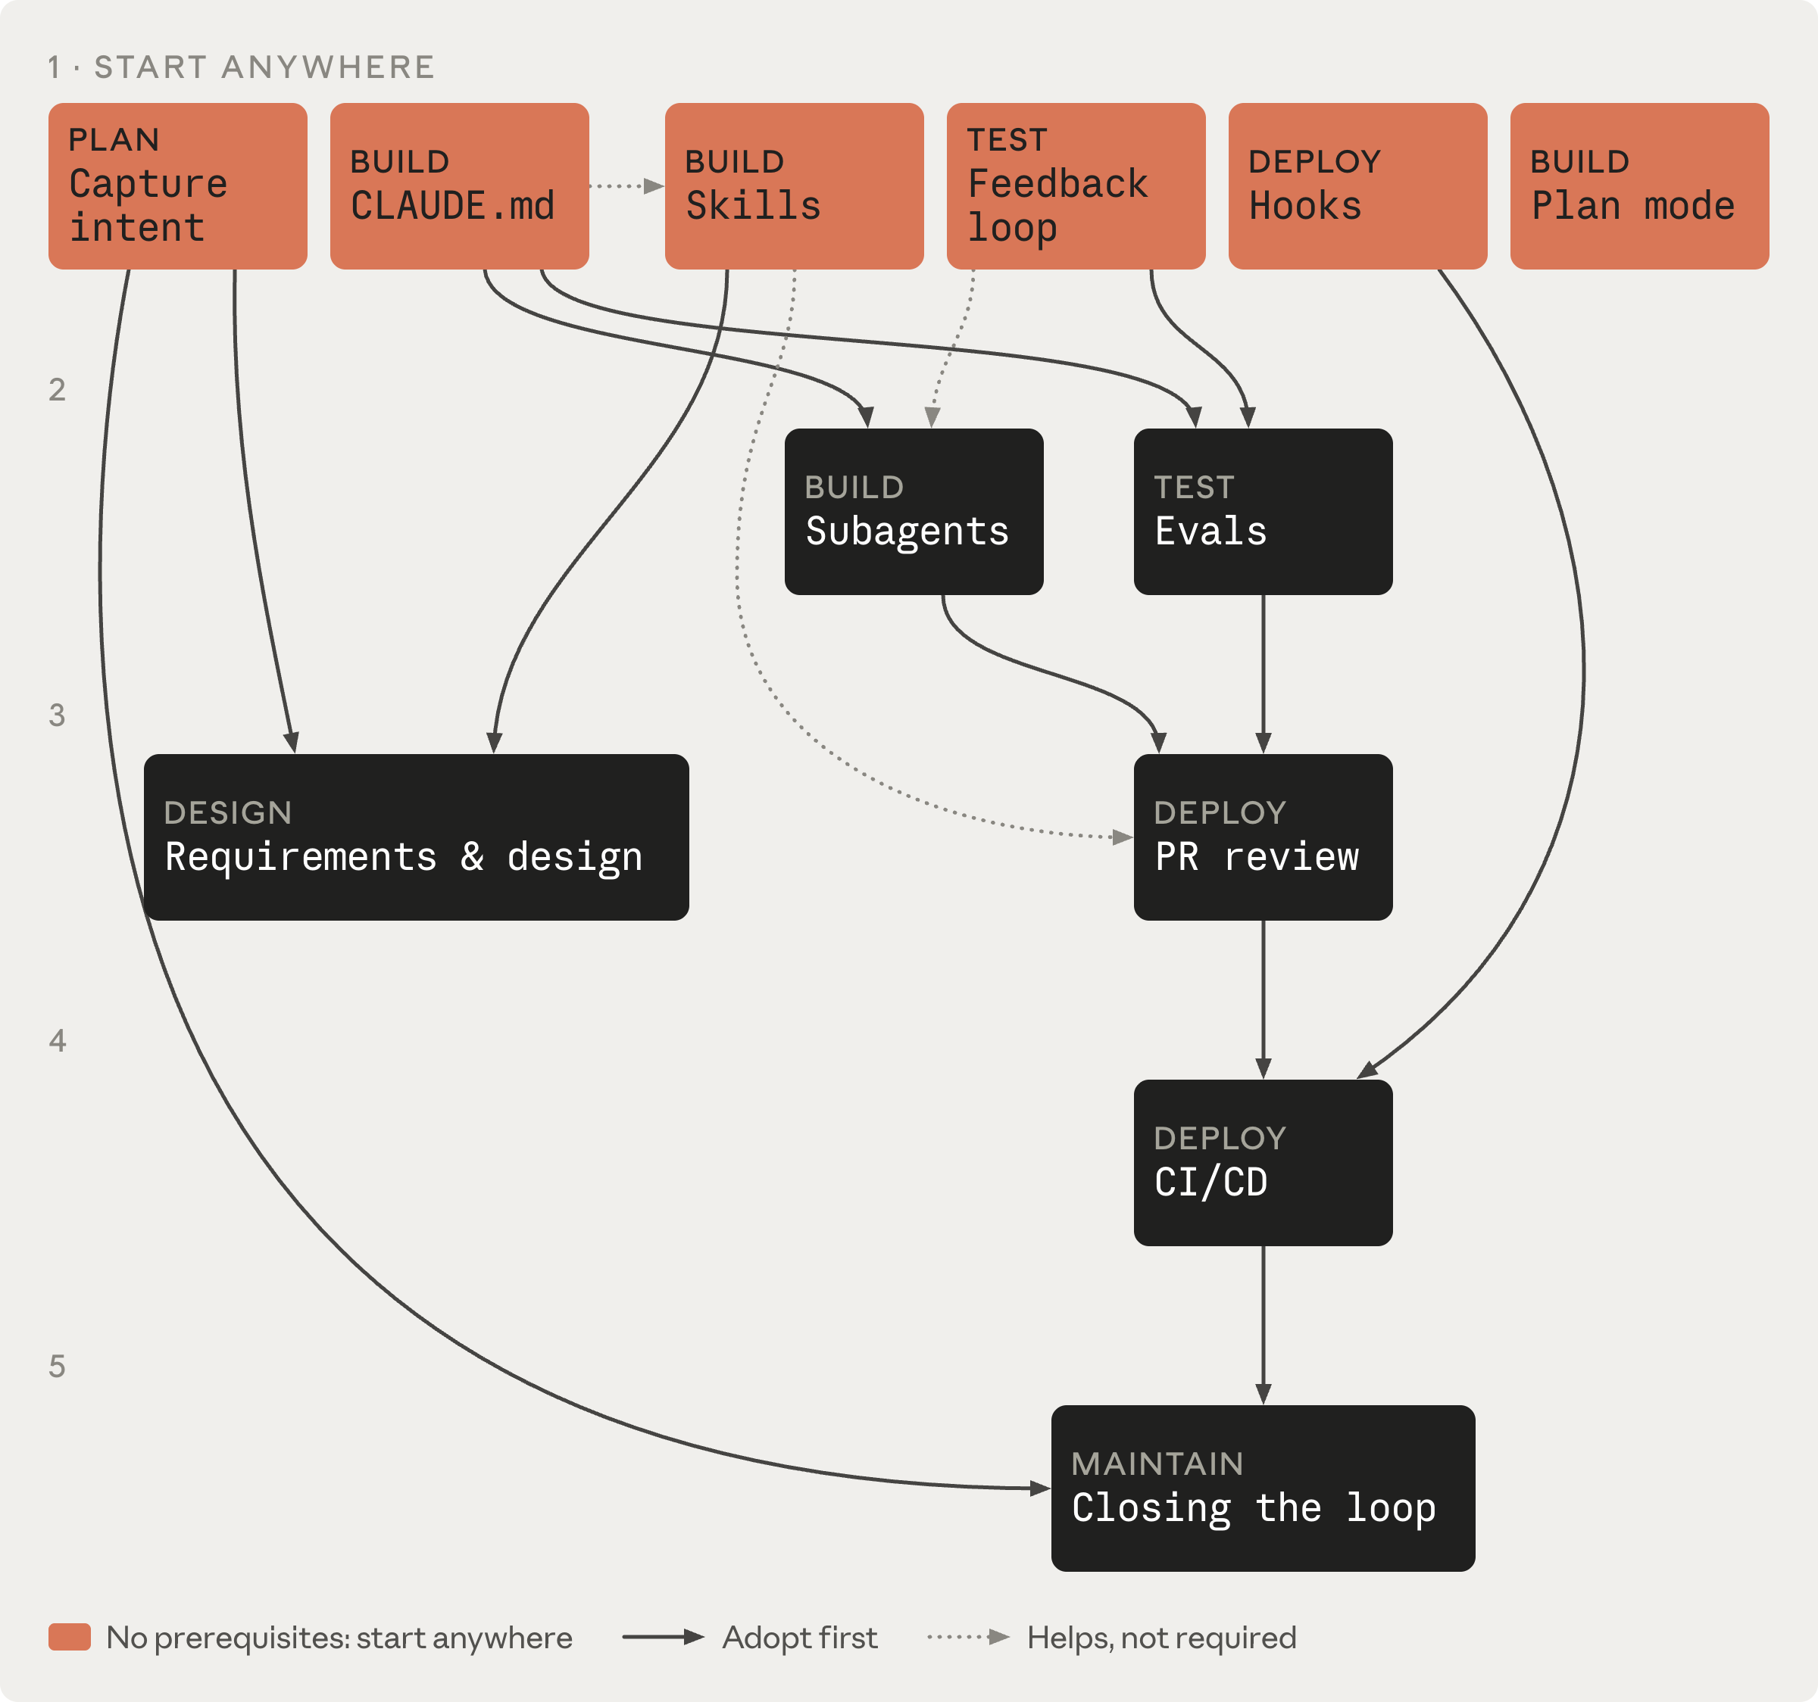
The play dependency graph
https://academy.claude.com/courses/ai-native-sdlc-playbook/introduction

Slide 16
The AI-Native SDLC playbook
Each stage ends by writing one to version control and the next stage begins by reading it.
For the early stages, .md files are the predominant artifact because a product owner and an agent can both read and act on the same file.
From Build onward, the artifact is code and its records.
The chain of commits is also the audit trail: who asked for what, what the agent produced, and who approved it.

Slide 17
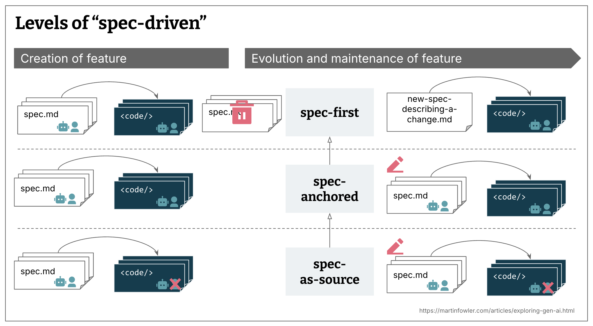
SDD Approaches
Spec-first: A well thought-out spec is written first, and then used in the AI-assisted development workflow for the task at hand.
Spec-anchored: The spec is kept even after the task is complete, to continue using it for evolution and maintenance of the respective feature.
Spec-as-source: The spec is the main source file over time, and only the spec is edited by the human, the human never touches the code.

Slide 18
The challenge with SDD tools
Harder to evaluate their usefulness for brownfield codebases.
False sense of control
Reviewing markdown over reviewing code

Slide 19
AI Requirements Elicitation
Requirements elicitation remains one of the least automated stages of software delivery.
Requirements elicitation is the process of discovering, understanding and documenting what stakeholders need from a proposed system.
Common elicitation techniques
  Stakeholder interviews
  Workshops
  Observation
  Document analysis
  Surveys
  Process mapping
  Prototyping

Slide 20
References
https://claude.com/blog/the-ai-native-sdlc-playbook
https://developer.microsoft.com/blog/spec-driven-development-ai-native-engineering/
https://martinfowler.com/articles/exploring-gen-ai/sdd-3-tools.html

Slide 21
Thank you

